Slide 1
Deep dive into software testing
Lecture 5
Notes:
Despre ce vorbim:
levels of testing (continuare)
performance testing, profiling
exotic testing techniques

Slide 2
Levels of testing
Unit testing
Integration testing
System testing
Acceptance testing

Slide 3
Integration testing
Why?
interface ConfigStore { String getConfigValue(String key); }
Notes:
Două echipe diferite implementează & folosesc interfața
- ați pune în producție?

Slide 4
Integration testing
Why?
Different assumptions of people implementing various modules
Different understanding of non-explicit parts of the interface
e.g., exceptions, error handling, string formats etc.
Poorly documented third-party APIs
etc.
Notes:
Alte exemple:
- Schema registry identity descriptors:
- separator . vs /
- max 300 returnate

Slide 5
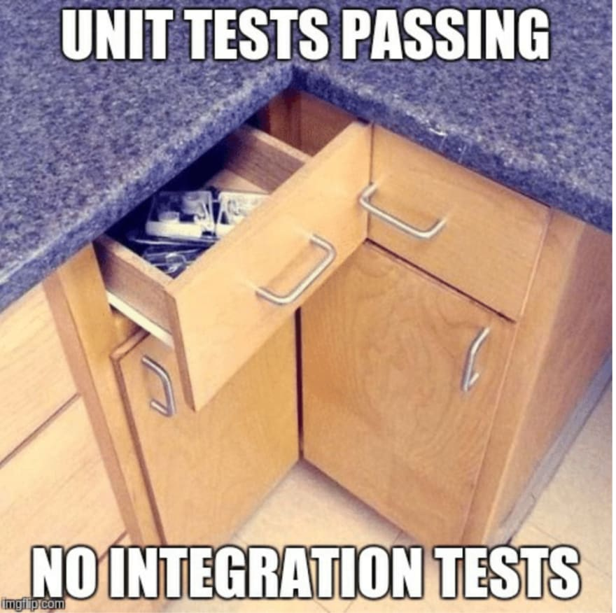
Integration testing
Test the interfaces and interactions between the software modules / units
Software modules are integrated logically and tested as a group
Normally done after unit testing
Replace mocks with the real thing (where possible)

Slide 6
Integration testing
Unit test:
@Mock
InformationRepository mockInformationRepository;
@InjectMocks
HelloWorldService helloWorldService = new HelloWorldService();
Integration test:
@Autowired
InformationRepository informationRepository;
@Autowired
HelloWorldService helloWorldService;
Notes:
Cine de aici a scris unit teste folosind mocks, vreodată?
Discuție despre mocks, de ce ne trebuie, overuse etc.

Slide 7
System testing
Test the application as a whole
Both functional and non-functional tests
Environment very similar to production
Notes:
Testing components vs. testing flows

Slide 8
System testing
Types of system tests:
Functional
Performance
Usability
Accessibility
Security
Regression
etc.
Notes:
usability vs cost

Slide 9
System testing
Pro:
Validates entire product
Conditions close to production
Con:
Expensive
Time consuming
vs. coverage
Fragile

Slide 10
Acceptance testing
Does the system satisfy the needs and requirements of its final users?
Is it ready?
Done by users / customers, usually manually
Two types:
Alpha:
Closed
Isolated environment
Beta
Open
Production environment
Notes:
But see also: perpetual beta
Types of Acceptance Testing:​
User Acceptance Testing (UAT): determine if the product is working for the user correctly​
Business Acceptance Testing (BAT): assess if the product meets the business goals​
Contract Acceptance Testing (CAT): includes terms such as - Service Level Agreement (SLA)​
Regulations Acceptance Testing (RAT): ensures rules and regulations defined by the government of the country where it is being released are followed​
Operational Acceptance Testing (OAT): testing of recovery, compatibility, maintainability, reliability​
Alpha Testing: assess the product in the development testing environment​
Beta Testing: assess the product by exposing it to the real end-users​

Slide 11
Behavior-Driven Development (BDD)
Write executable tests using business language
collaboration between business and technical people
build a shared understanding of the problem to be solved
develop system documentation that is checked against the system’s behavior
Notes:
Writing tests such that they can be understood / modified by business people
Only makes sense if there are actual business people involved.

Slide 12
BDD example
Feature: Account Holder withdraws cash Scenario: Account has sufficient funds Given the account balance is $100 And the card is valid And the machine contains enough money When the Account Holder requests $20 Then the ATM should dispense $20 And the account balance should be $80 And the card should be returned

Slide 13
Performance Testing

Slide 14
Why do we care about performance?
User experience
increased latency reduces user engagement
Accessibility
Not everyone has access to latest device
Decrease costs
Increase profit
Find bottlenecks
Prepare for scaling up and out
etc.

Slide 15
Performance Testing
Performance testing validates that the application:
is available and running under different load conditions (availability)
responds fast enough for different load conditions (response time)
processes the required number of transactions in any given interval (throughput)
delivers return on investment for the resources: hardware and software (capacity planning)
is comparable to or better than that of the competitors for different parameters (competitive analysis and benchmarking)
Performance testing is complex and expensive due to large resource requirements and the time it takes to perform it.
Notes:
capacity planning:
- media analytics & super bowl
- profit follows average, cost follows maximum
competitive analysis: Gemini, încadrare tipar

Slide 16
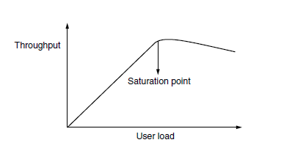
Latency vs Throughput
Latency
How fast can the software application return a response?
Measured in seconds
Throughput
How many responses can the software application return?
Measured in requests per second
The ideal situation: throughput increasing as the user load increases
Notes:
Să ne imaginăm un server http pe un RPi
Dăm cu 1 req / s, creștem -> ce și cînd se rupe?
La fel de ideal: pot scala orizontal indefinit, nothing shared

Slide 17
Types of performance testing
Load test
Evaluate system under expected load
Stress test
Higher than expected load: where does it break?
Endurance test
Run system for a long time
Can identify resource leaks
Spike test
How does the system react to a sudden increase in load?
Volume test
Feed the system a large amount of data
etc.
Notes:
Load test: 20 useri dacă asta se cere: întreținere, 112
Endurance aka soaking
Spike: auto-scaling, reacționează suficient de rapid?

Slide 18
The process of performance testing
Define scenarios
Determine user distribution
Write the test cases
Run the test
Analyse the results

Slide 19
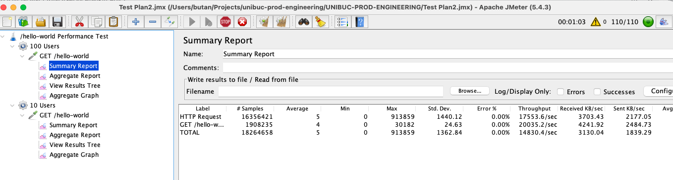
JMeter Performance testing
Open-source software, designed to load test functional behavior and measure performance:

Slide 20
Performance Profiling
Measure CPU time and/or memory usage of running code.
Provides easy access to detailed performance data about the software application.
Tools used are called performance profilers.

Slide 21
Performance Profiling
Profiling methods:
Instrumentation
detailed
but invasive
Sampling
less overhead
but approximative / probabilistic
Notes:
Sampling poți să faci și de mînă
Exemplu: deserializare în Spark

Slide 22
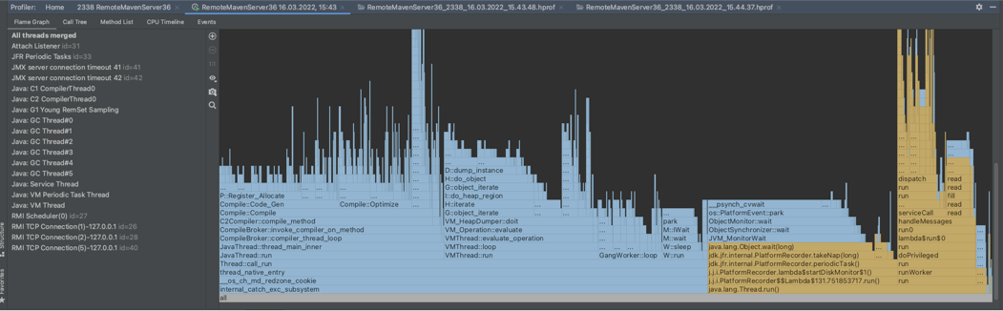
IntelliJ Profilers
Starting the application with a profiler is simple: click the Run icon near the entry point of your application and select the needed profiling tool (e.g. Run with CPU Profiler, Java Flight Recorder)

Slide 23
More exotic testing techniques

Slide 24
Testing in Production
Modern software solutions are too complicated to test comprehensively before deploying
Some behaviors only happen at prod scale
We want fast feedback, but we also want less risk of breaking things
Idea: separate deployment from release
By:
blue / green deployments
feature flags
etc.
Use monitoring to make sure everything still works as expected
Notes:
soluție software modernă e complicată
nu e fezabil să testezi toate combinațiile
sunt chestii care nu se întîmplă decît la scara din producție
pui în prod
ai feature flags
enable la x% din useri
uiți la metrici
dacă e ok dai rollout mai departe
dacă nu faci roll back
Reduce risk vs. Quick feedback
Blue/Green deployment
A/B testing
We can react & fix things much faster than we used to
Customers are the best testers

Slide 25
Property testing
The idea: specify properties that a function should hold, instead of individual test cases
The testing framework will then generate random inputs and check the properties for all of them
Example:
instead of asserting that sorted([2, 1, 3]) == [1, 2, 3]
define the following properties:
the result of sorted has the same length as the input
the result of sorted should be monotonically increasing
Is this enough to make sure the sorted function is correct?

Slide 26
Property testing
Advantages:
Catches edge cases
Runs more tests than you’d right by hand
The properties document the behavior of the function
Limitations:
It could be hard to come up with properties
Can be too abstract, sometimes a concrete example is clearer
Example frameworks:
QuickCheck (Haskell, the OG)
ScalaCheck (Scala)
Hypothesis (Python)
jqwiq (Java)

Slide 27
Fuzz testing
Try to crash the system by feeding it randomly generated input
Main purpose: identity security problems, improve error handling
Example tools:
American Fuzzy Lop / AFL++
FuzzTest (for C++)
etc.

Slide 28
Software Engineering Lore
https://learning.oreilly.com/library/view/software-testing-principles/ Software Testing: Principles and Practices, Srinivasan Desikan, Gopalaswamy Ramesh – Section 1.8: The Pesticid Paradox
https://learning.oreilly.com/library/view/clean-code/ "Clean Code - A Handbook of Agile Software Craftsmanship", Robert C. Martin - Ch.9 Unit Tests
https://www.testbytes.net/blog/quality-assurance-process-methodology/
https://smartbear.com/learn/code-profiling/fundamentals-of-performance-profiling/
https://blog.jetbrains.com/idea/2021/05/get-started-with-profiling-in-intellij-idea/
https://cucumber.io/docs/bdd/

Slide 29
Thank you!!

Slide 30
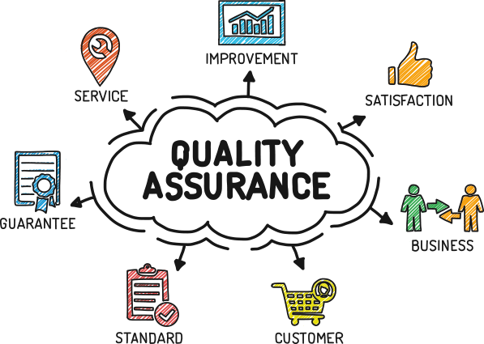
How can one guarantee that it provides the best possible product to customers?
Quality assurance is the sum of activities performed to ensure the quality of a service or product.
Quality is defined by meeting the needs and expectations of customers with respect to functionality, design, stability, and the price of the product.
Assurance provides a guarantee that the product will work without any problems based on business requirements.
Quality assurance activities:
inspection activities;
detection of problems;
resolution of problems;
delivery of satisfactory outcomes;

Slide 31
Quality Assurance process
Invest in User Experience
when UX is terrible => the quality isn’t of standard
Automation and Continuous Integration
quick review, early defects detection and improved productivity
Test and Code Coverage
minimum 90% function code coverage to guarantee the best outcomes
Smart Testing
how and what to test
Bug Prevention
concentrate on major crucial bugs and errors at first as opposed to many small errors
Portability
important for software to adjust to various environments
Reliability
the system needs to be ready to get back into complete control even after a possible malfunction in components
Documentation
Notes:
What do we mean by test coverage?

Slide 32
Test Plan
A Test Plan is a document containing software testing scope and activities
Describes the scope, approach, resources and schedule of intended test activities
Identifies:
the features to be tested
testing tasks
the test environment
the test design techniques
entry and exit criteria to be used
risks
Define scope of testing
Identify testing type
Document risks and issues
Create tests logistics

Slide 33
How to define a test plan?
The content may vary based on the processes, standards, and test tools used.
Example of a Test Plan Template:
Introduction: overview of the test plan, specify the goals/objectives, and any constraints.
References: list related documents
Test Items: list the test items (software/products) and their versions
Features to be Tested: list features of the software/product to be tested, provide references to the requirements and/or design specifications of the features to be tested
Features Not to Be Tested: list features of the software/product which will not be tested, specify the reasons these features won’t be tested.
Approach: specify the testing levels, the testing types
Item Pass/Fail Criteria: the criteria that will be used to determine whether each test item (software/product) has passed or failed testing

Slide 34
System Testing
System Testing is used to evaluate the design and behavior of the system and the expectations of the customer
The main goal is to detect defects within both the integrated units and the whole system
Performed after the integration testing and before the acceptance testing
Types of System Testing:
Performance Testing: tests the speed, scalability, stability and reliability of the software product
Load Testing: determine the behavior of the system under extreme load
Stress Testing: check the robustness of the system under the varying loads
Scalability Testing: measures performance of the system when the number of user requests are scaled up or down

Slide 35
Steps of performance testing
Collecting requirements
what factors needs to be measured and improved: response time, latency, throughput, resource utilization
Writing test cases
Automating performance test cases
Executing performance test cases
Analyzing performance test results
Performance tuning
narrowing down the list of parameters that really impact the performance results
Performance benchmarking
comparing the performance of the product with that of the competitors
Recommending right configuration for the customers (Capacity Planning)

Slide 36
End-to-end testing
Test an application under real life circumstances
Simulate real user scenarios
Validate that the application is functional at every level
End to End Testing Design Framework:
Build user functions
List the features and their interconnected components
List the input data, action and the output data for each feature
Identify the relationships between the functions and if the function is reusable or independent
Build conditions
For each user function, a set of conditions should be prepared
Build test cases - for every scenario, one or more test cases should be created to test each functionality of the user functions

Slide 37
End-to-end Example
Build User Functions
Login into the system
Logout of the application
Build Conditions based on User Function
Invalid Username and Password
Checking with valid username and password
Password strength checking
Checking of error messages
Build a Test Scenario
Login into the system
View user profile
Logout of the system

Slide 38
Test-Driven Development
Test-Driven Development (TDD) refers to a style of programming in which three activities are tightly interlinked: coding, testing and design.
The Three Laws of TDD:
First Law: You may not write production code until you have written a failing unit test.
Second Law: You may not write more of a unit test than is sufficient to fail (not compiling is failing).
Third Law: You may not write more production code than is sufficient to pass the currently failing test.
=>
Dozens of tests every day
Hundreds of tests every month
Thousands of tests every year
Those tests will cover virtually all the production code.
Notes:
But see also https://tidyfirst.substack.com/p/canon-tdd

